Slide 1
GOVERNMENT OF INDIA

Slide 2
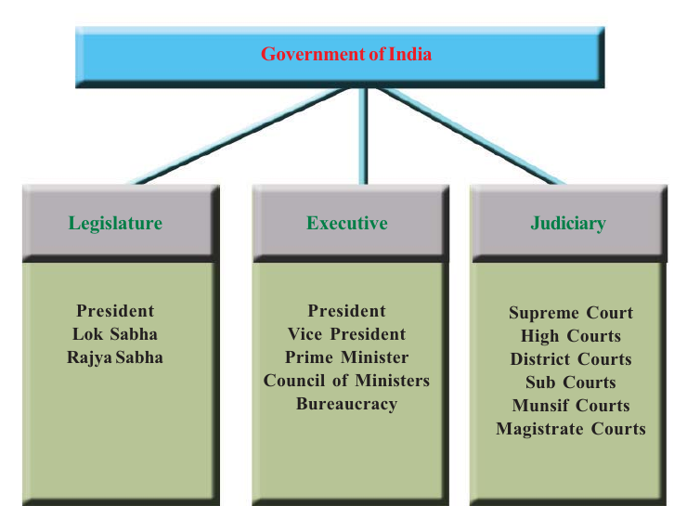

Slide 3
video

Slide 4
PARLIAMENT
THE LEGISLSTURE IN INDIA IS KWON AS THHE PARLIAMENT
It consists of the President and the two houses of namely Rajya Sabha and Lokh Sabha.
The Rajya Sabha is known as the upper house
The Lokh Sabha is known as the lower house
It has two houses it is known as Bicameral Legislature

Slide 5
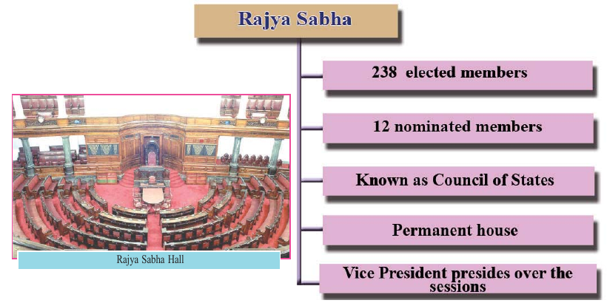
Read more

Slide 6
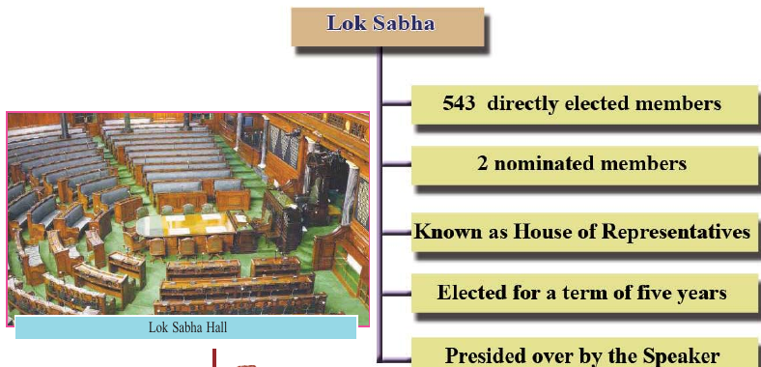
Read More

Slide 7
Functions of Parliament
Legislation Read More
Making bill in to law
A law in draft form is known as a bill

Slide 8
The various stages of passing a bill
First Reading
The bill is introduced
Second Reading
Each and every article included in the bill either passed ,changed or rejected after discussion
Third Reading
The bill as a whole is passed or rejected
After passing the billin the first house ,it is sent to the second house along with the certificate of the presiding officer.
The bill passes once again through the above mentioned three stages in the second house
After the bill is passed by both houses,it is sent to the President for approval
On getting the approval of the President ,the bill becomes a law.

Slide 9
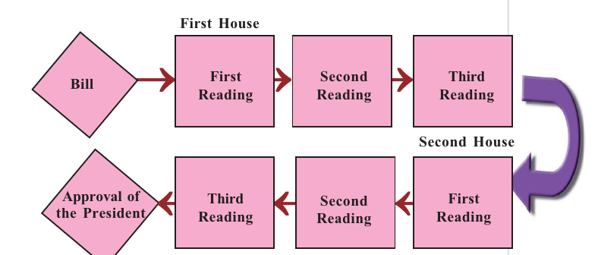
Various stages of passing a bill

Slide 10
video

Slide 11
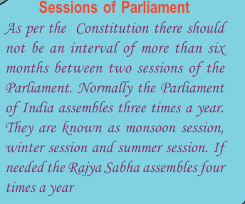

Slide 12
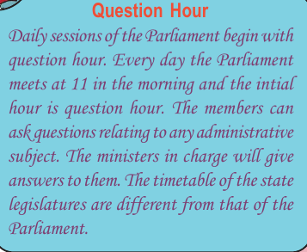

Slide 13
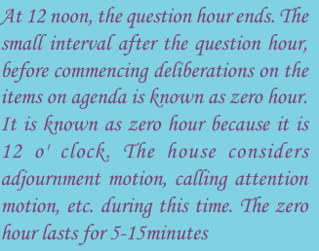
Zero hour

Slide 14
Money Bill
Any billrelating to the collection of revenue or expenditure from the consolidated fund can be termed as money bill

Slide 15
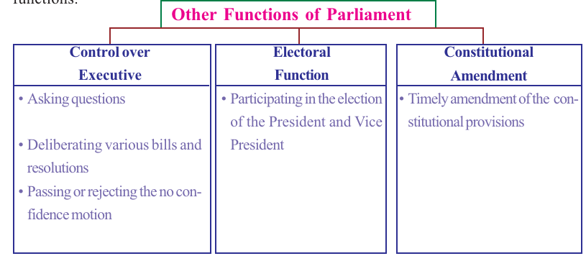

Slide 16
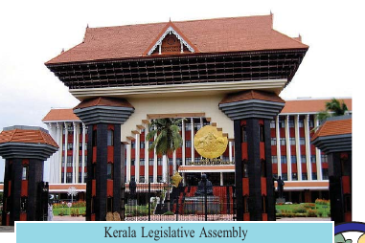

Slide 17
State legislature
Unicameral legislature
Bicameral Legislature

